Slide 1
Pythagoras
EQ: How do we find the short side

Slide 2
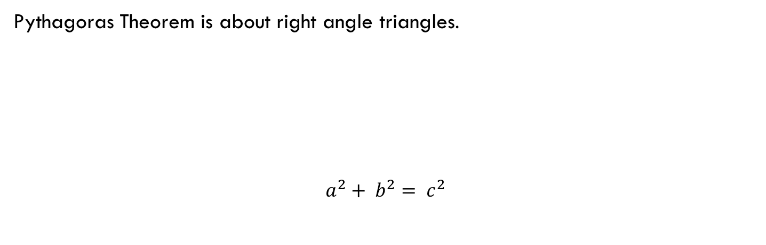
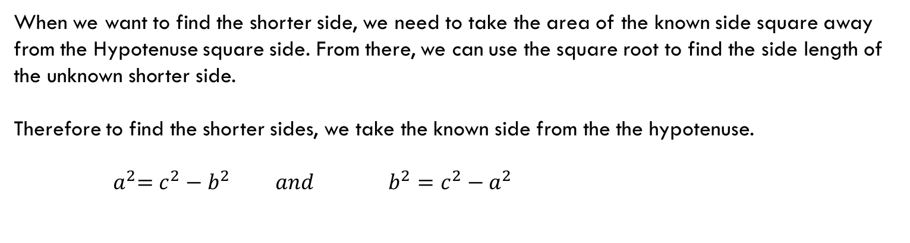
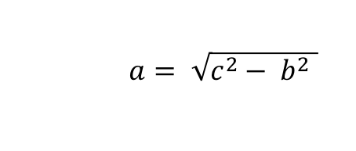
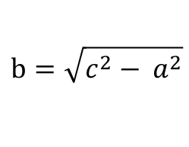
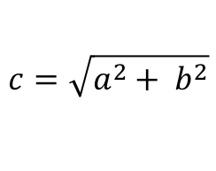
24
7
30
Topic: Pythagoras Theorem
Date: /06/2018
EQ – How do I calculate the shorter side of a right-angled triangle?
Pythagoras Theorem is about right angle triangles.
$$a^{2}+ b^{2}= c^{2}$$
C - Hypotenuse
A
B
When we want to find the shorter side, we need to take the area of the known side square away from the Hypotenuse square side. From there, we can use the square root to find the side length of the unknown shorter side.
Therefore to find the shorter sides, we take the known side from the the hypotenuse.
$${ a}^{2}=c^{2}−b^{2} and b^{2}=c^{2}−a^{2}$$
Remembering our algebra skills, to remove the square on the left, we square root the right hand side
$a= \sqrt{c^{2}− b^{2} }$
$$b=\sqrt{c^{2}− a^{2}}$$
$$c=\sqrt{a^{2}+ b^{2}}$$

Slide 3
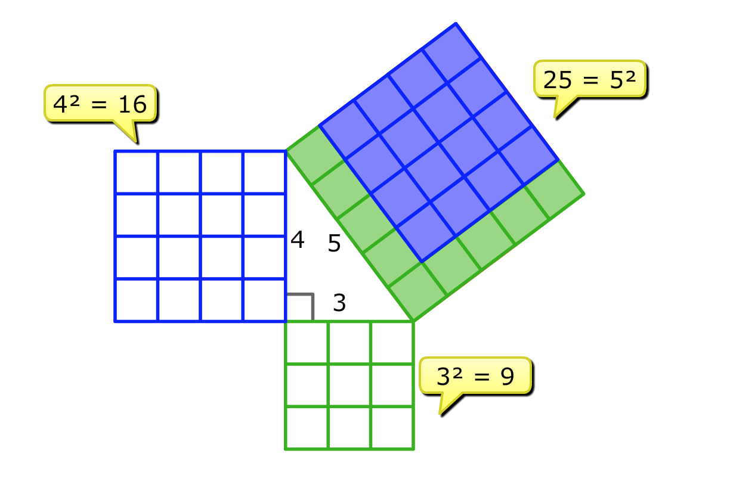
Topic: Pythagoras Theorem
EQ – How do I calculate the shorter side of a right-angled triangle?
Looking at this example, see that the hypotenuse square is 25 units. The square root of 25 is 5, so this length is 5 units long.
We also know that the blue side is a square of 16 units. The square root of 16 is 4, so if we remove 16 units from our long side of 25 units, we are left with 9 units.
9 units, means that the square root of 9 will be our last side length. The square root of 9 is 3. So the missing short side is 9.

Slide 4
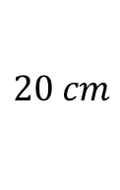
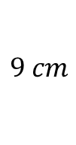

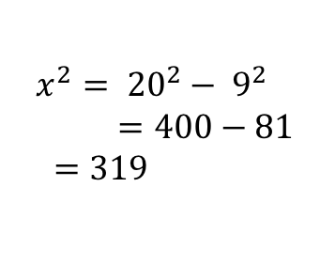
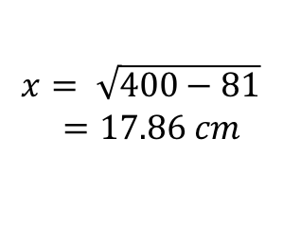
24
7
30
Topic: Pythagoras Theorem
Date: /06/2018
EQ – How do I calculate the shorter side of a right-angled triangle?
shorter side
$$x^{2}= {20}^{2}− 9^{2}$$
$=400−81$
$$=319$$
$$9 cm$$
$$x$$
$$x= \sqrt{400−81}$$
$=17.86 cm$
$$20 cm$$
hypotenuse

Slide 5

We Do
Determine the length of the unknown side of this right-angled triangle.
$$e^{2}=f^{2}−d^{2}$$
$$e^{2}={10}^{2}−8^{2}$$
$$f^{2}=100−64$$
$$f^{2}=36$$
$$f=\sqrt{36}$$
$f=6$ cm
d = 8 m
e
f = 10 m

Slide 6


